Slide 1
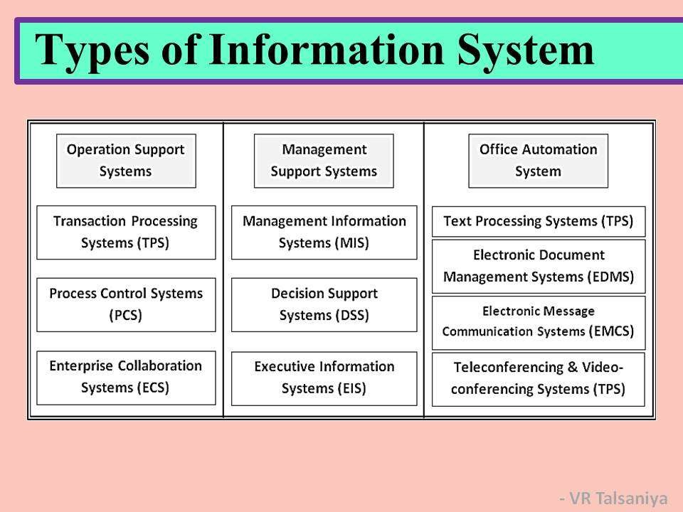

Slide 2
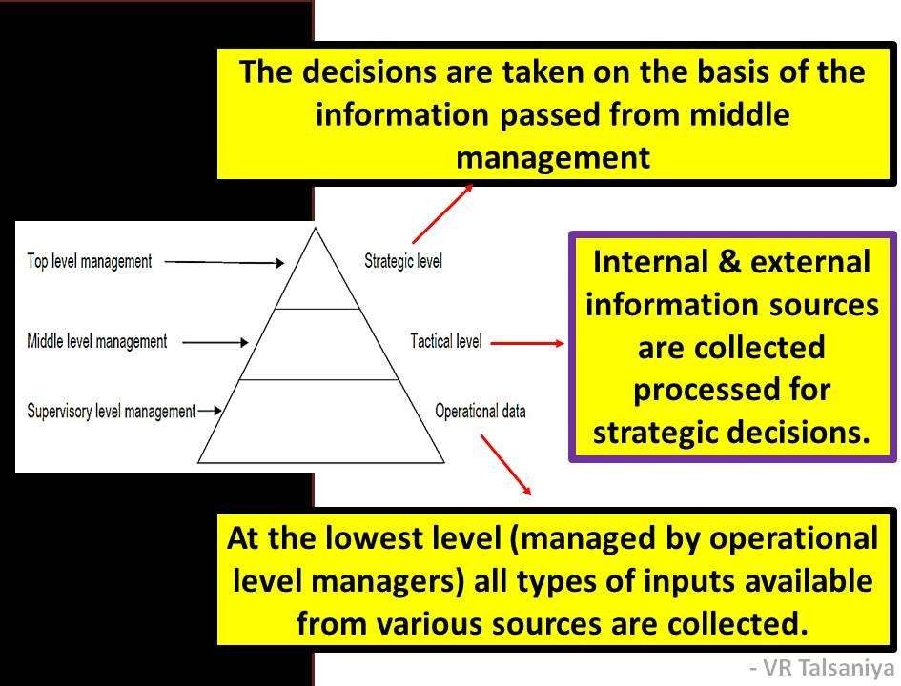

Slide 3
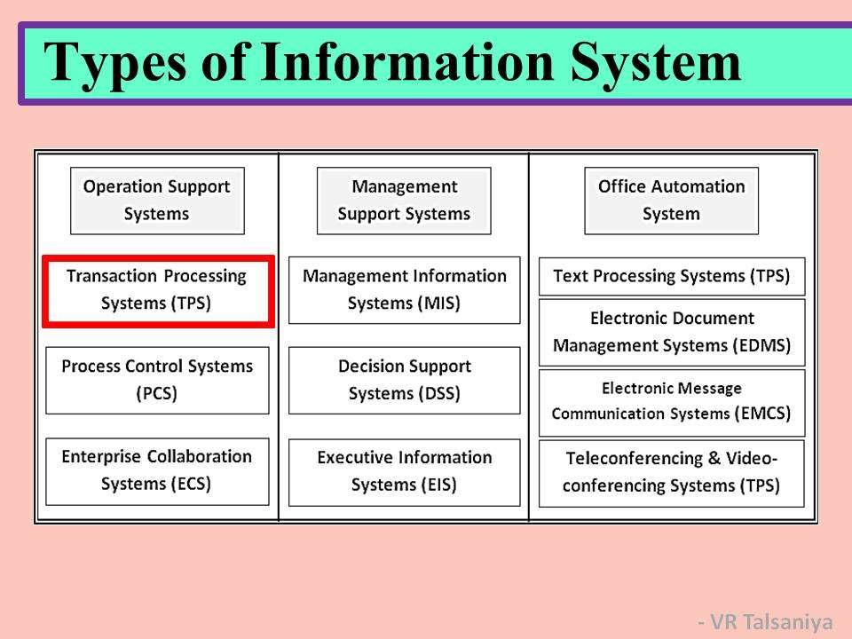

Slide 4
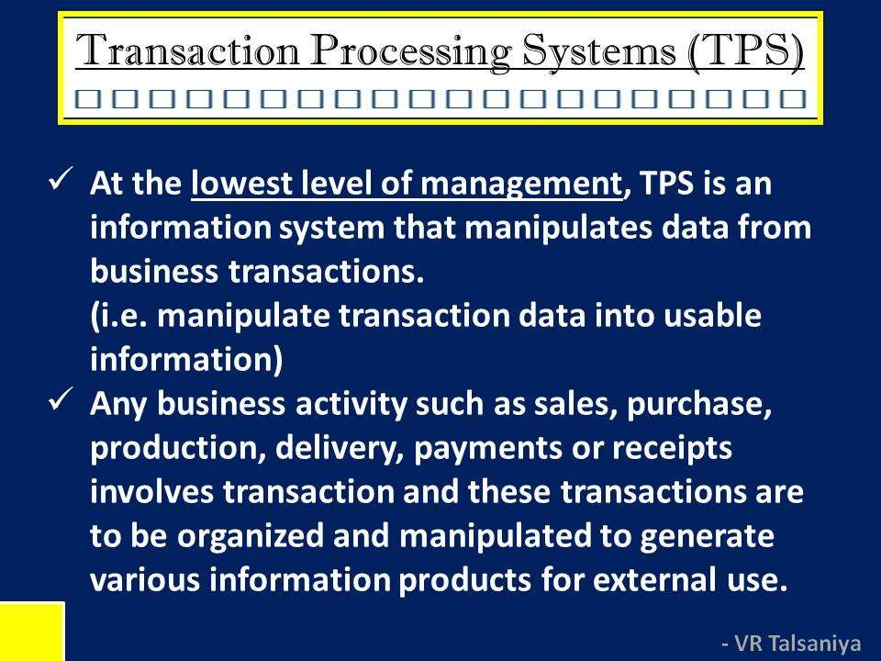

Slide 5
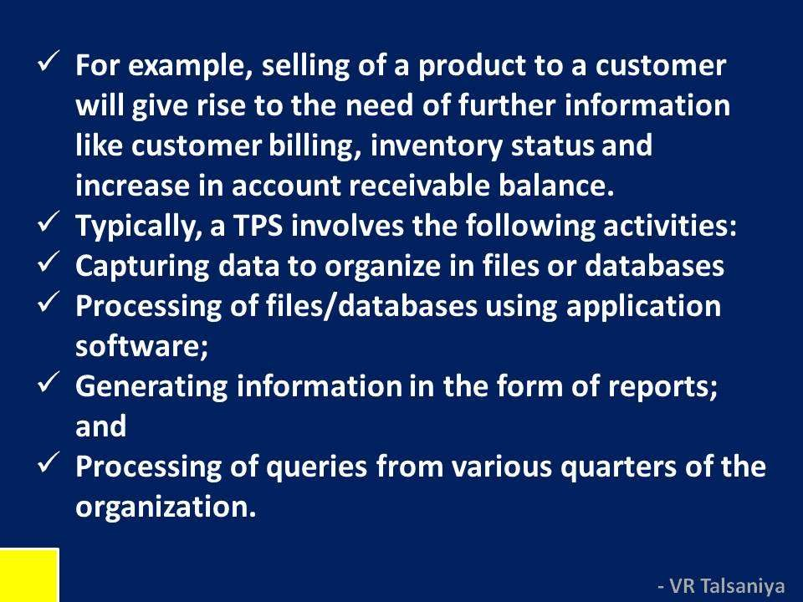

Slide 6

A PAYROLL TPS
To general ledger
EMPLOYEE DATA
Payroll System
Employee
/file database
Management reports
Employee number Address Pa rate Gross pay Federal tax Medicare State tax Net pay
To government
agencies
Employee paychecks
Online queries

Slide 7
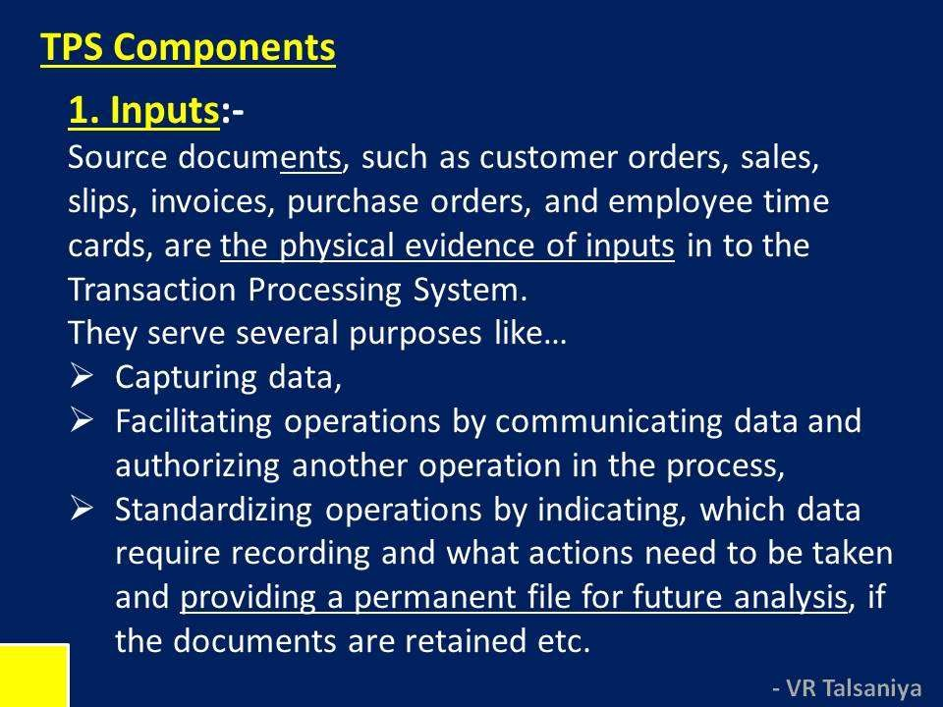

Slide 8
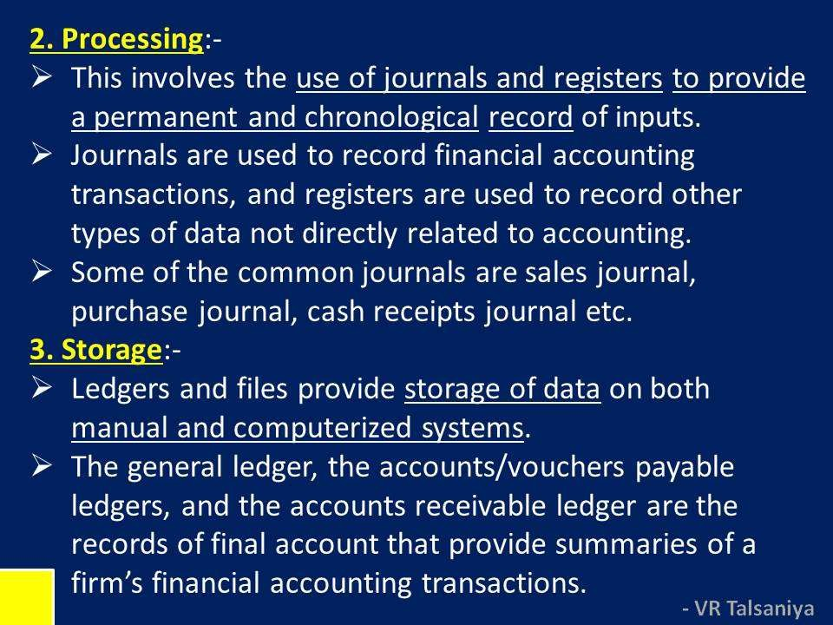

Slide 9
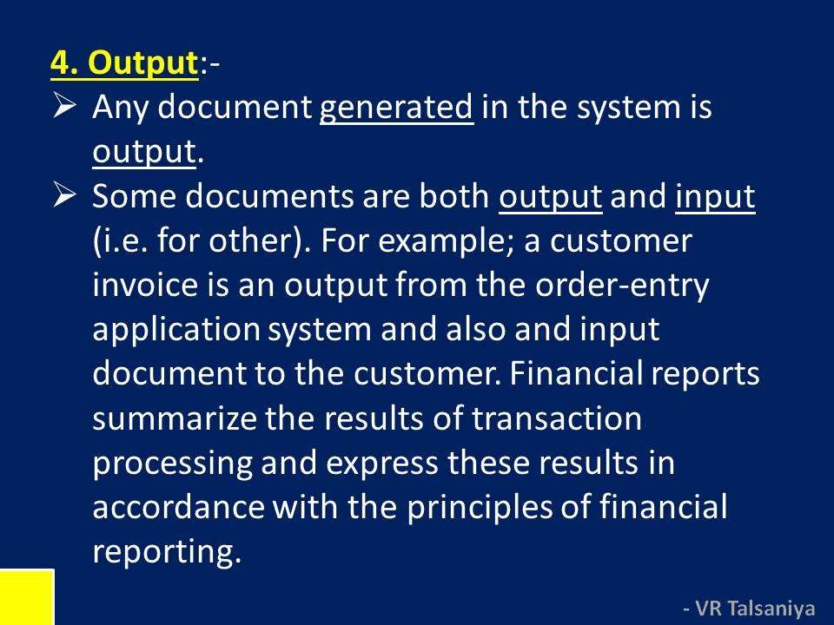

Slide 10
Objectives of TPS
Process data generated by and about transactions
Maintain a high degree of accuracy and integrity
Avoid processing fraudulent transactions
Produce timely user responses and reports
Increase labor efficiency
Help improve customer service
Help build and maintain customer loyalty
Achieve competitive advantage

Slide 11
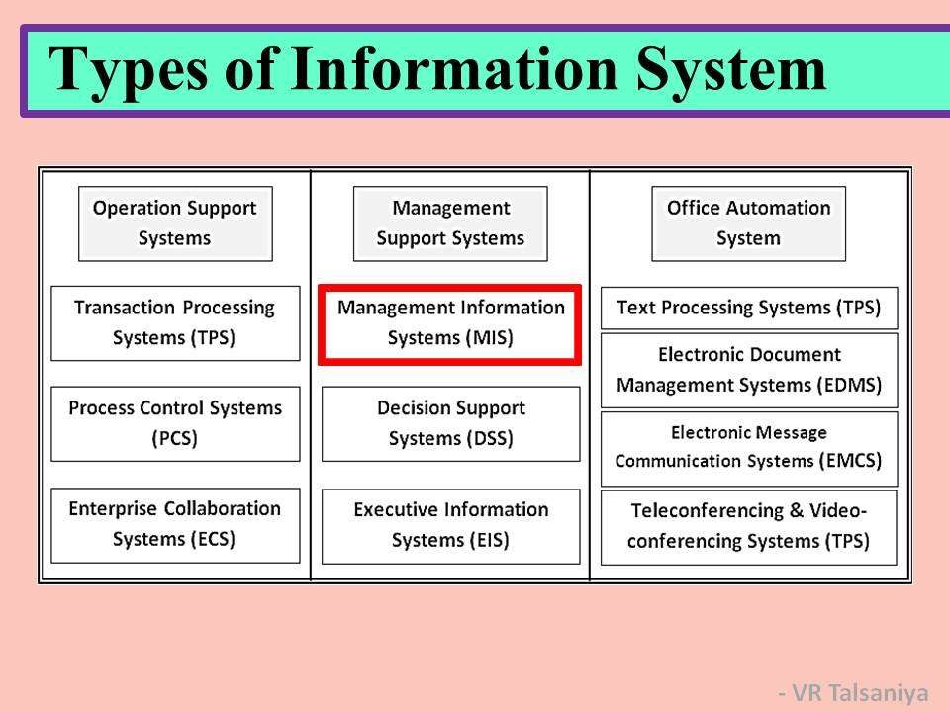

Slide 12
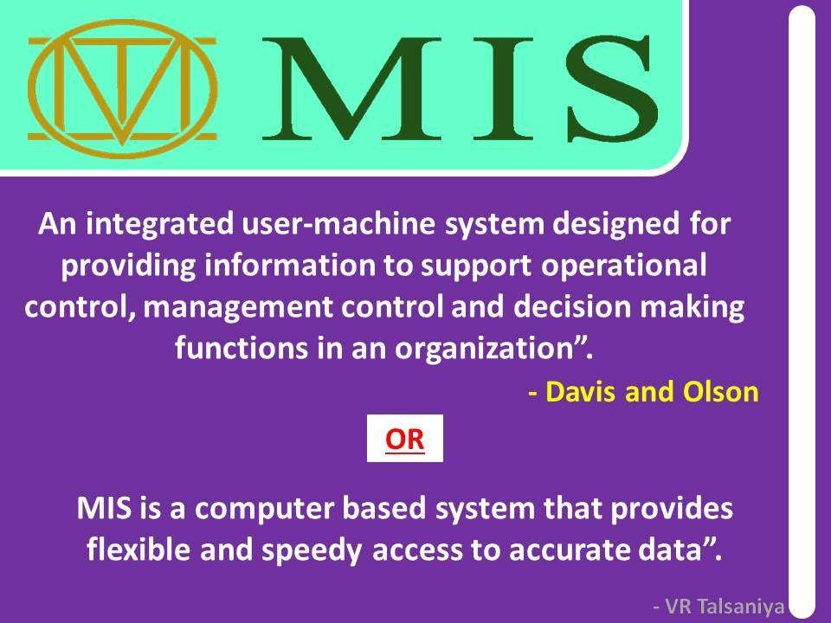

Slide 13

MIS
Designates a specific category of information systems serving middle management.
Provides middle managers with reports on organization’s current performance.
Information thus obtained is used to monitor and control and business and predict future

Slide 14
Characteristics of MIS
MIS is an integrative system
MIS is Sub System concept
Provides relevant information to management
MIS is flexible
Enhances productivity
Is a coordinated system
Feedback system

Slide 15
Mmanagement information system
MIS
TPS
Order file
Order Processing system
Sales data
 | Materials Resoure Planning system
MIS
reports
Unit Product Cost data
Production Master
file
Product change data
managers
General Ledger system
Accounting
file
Expense data

Slide 16
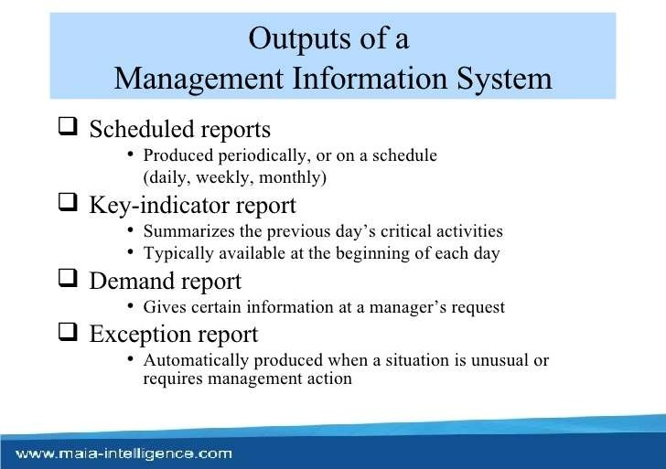

Slide 17
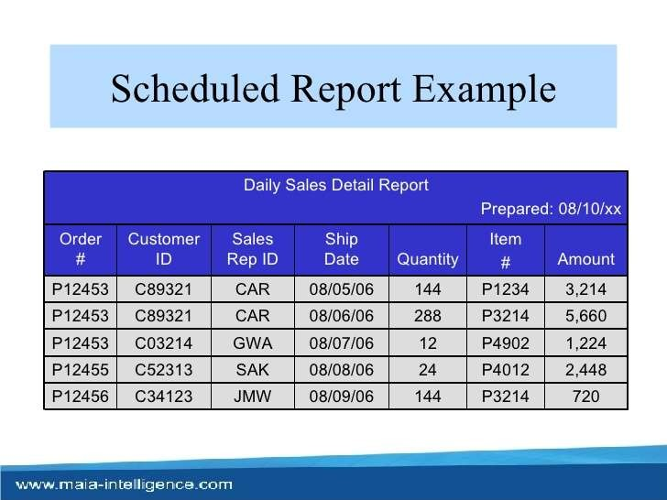

Slide 18
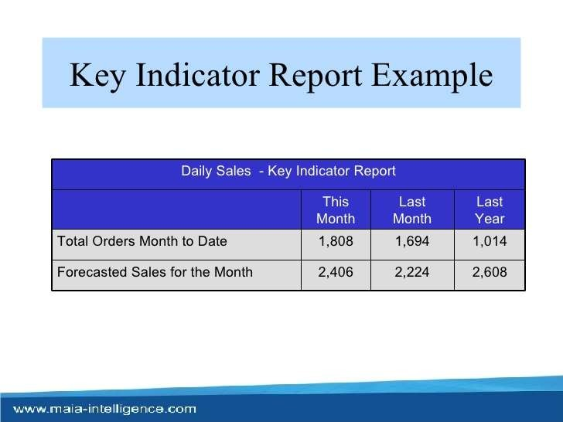

Slide 19
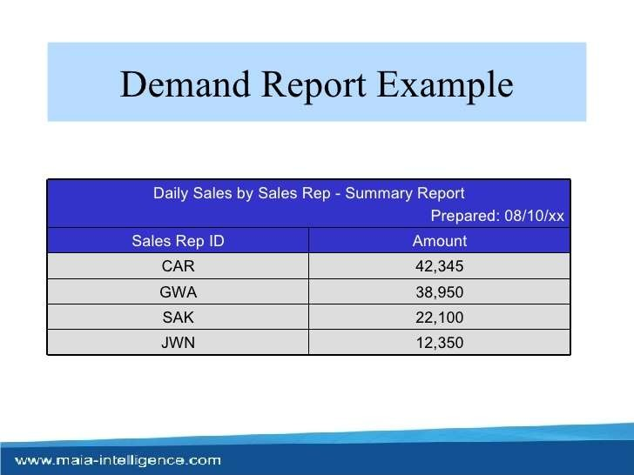

Slide 20
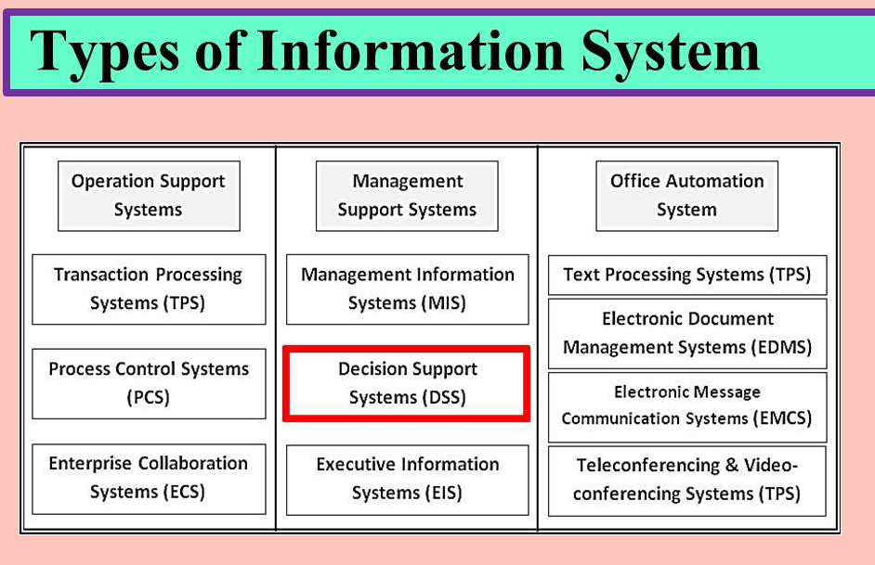

Slide 21
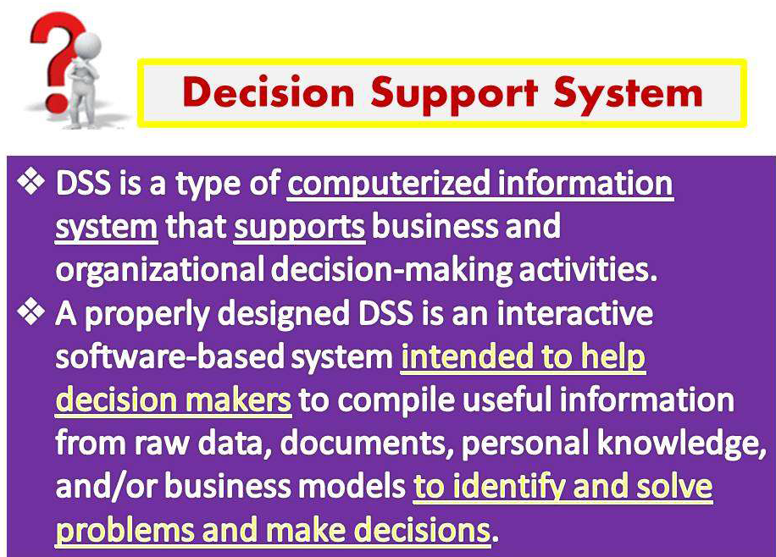

Slide 22
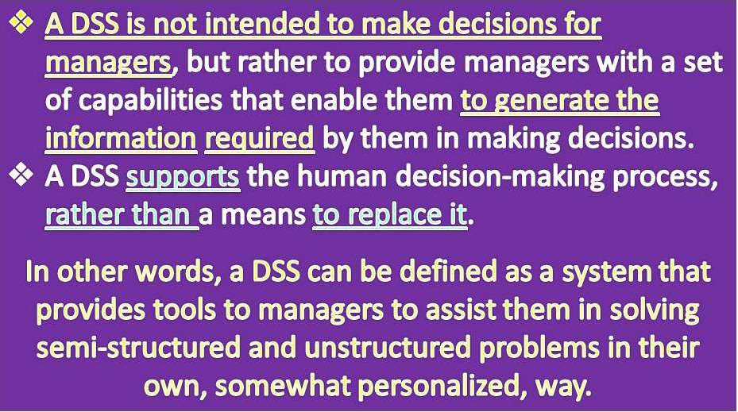

Slide 23
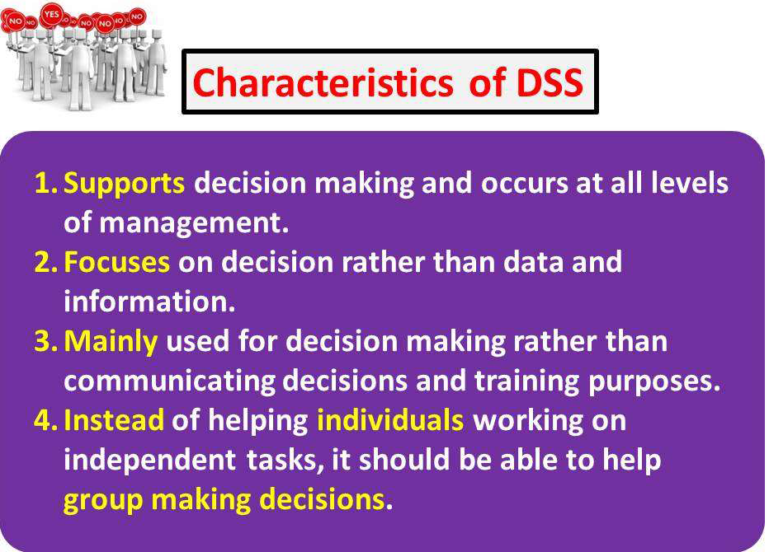

Slide 24
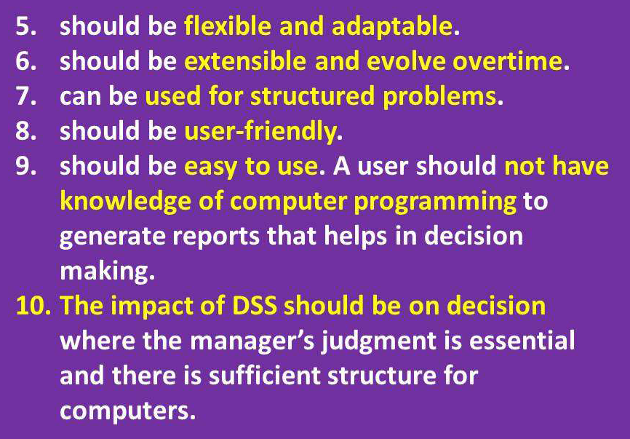

Slide 25
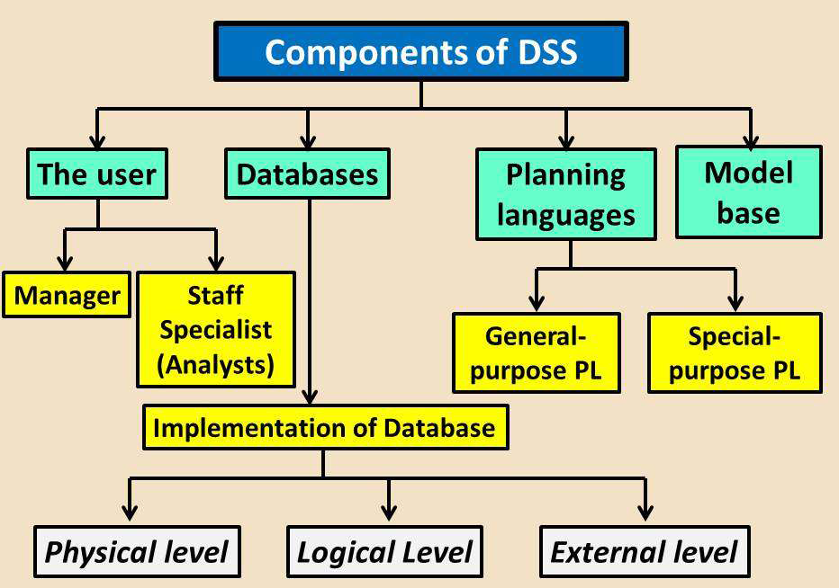

Slide 26
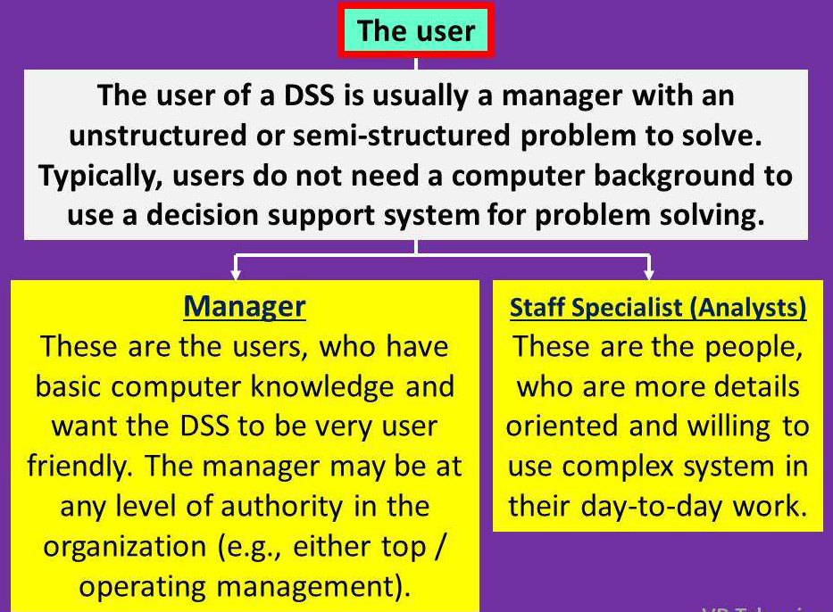

Slide 27
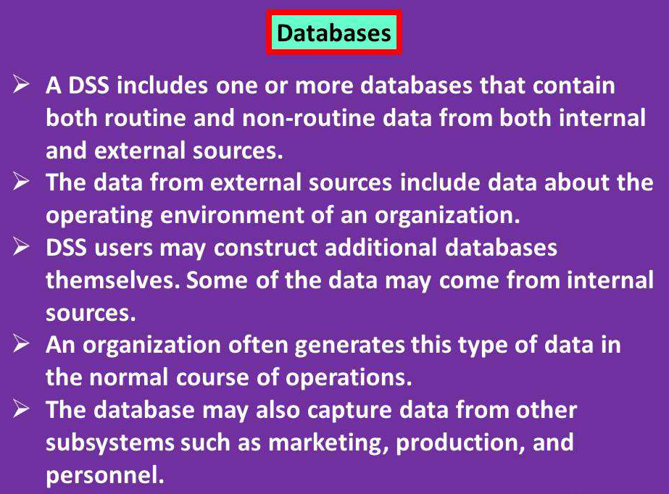

Slide 28
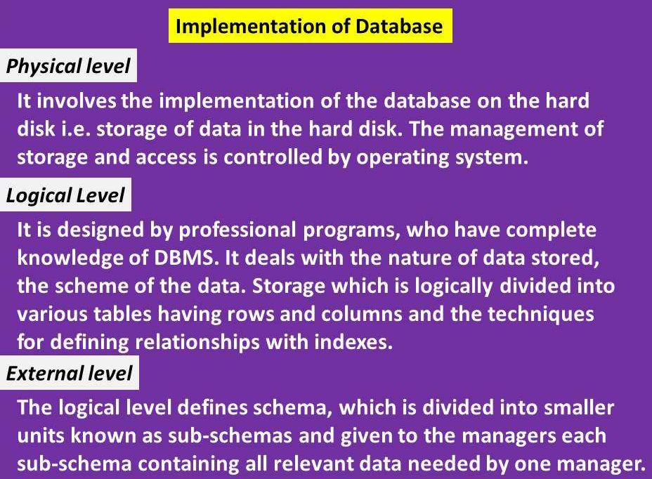

Slide 29
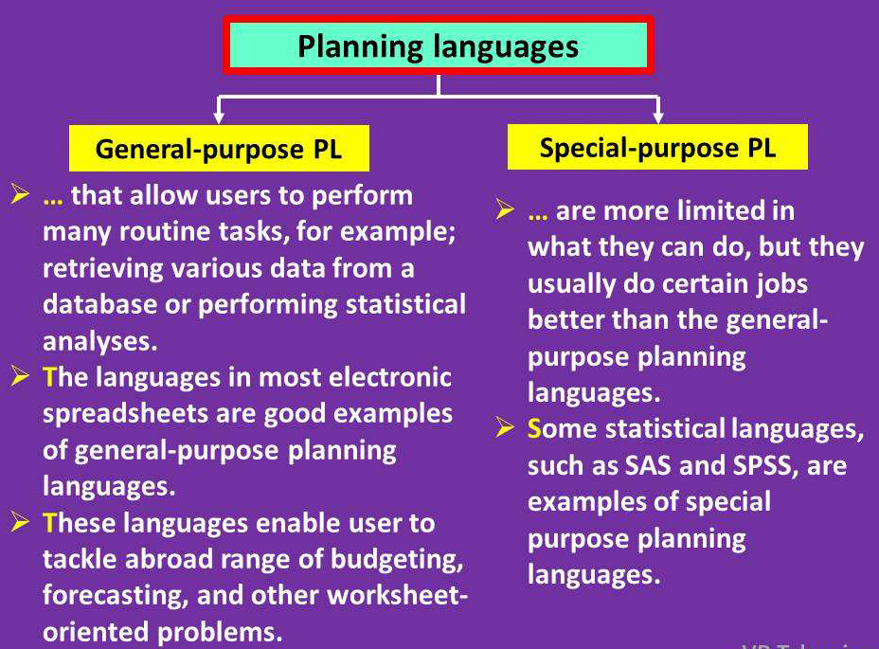

Slide 30
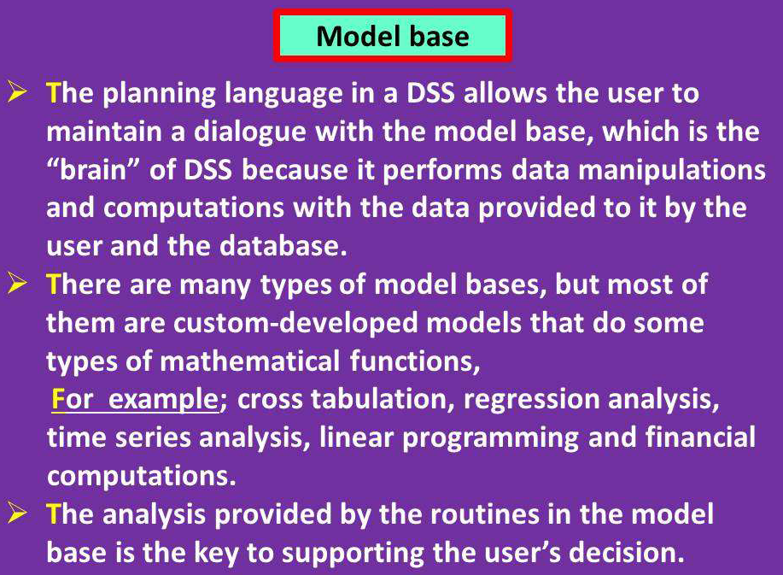

Slide 31
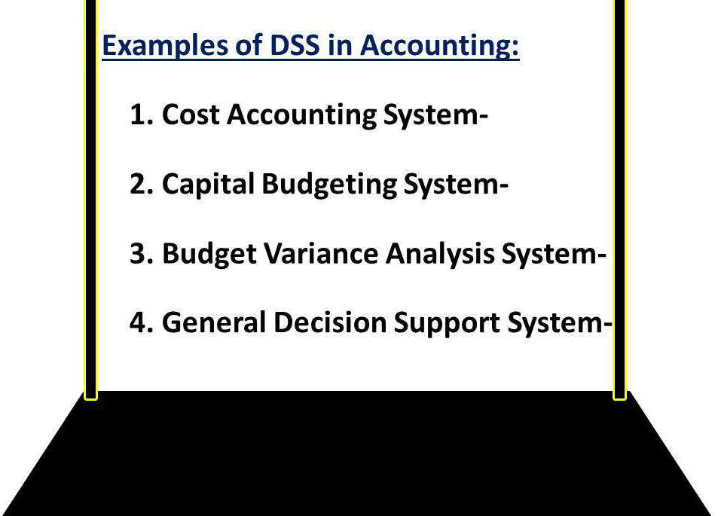

Slide 32
EXPERT SYSTEM

Slide 33
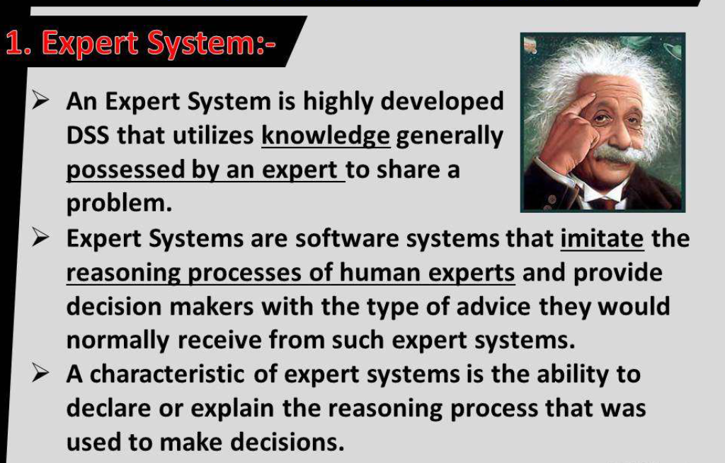

Slide 34
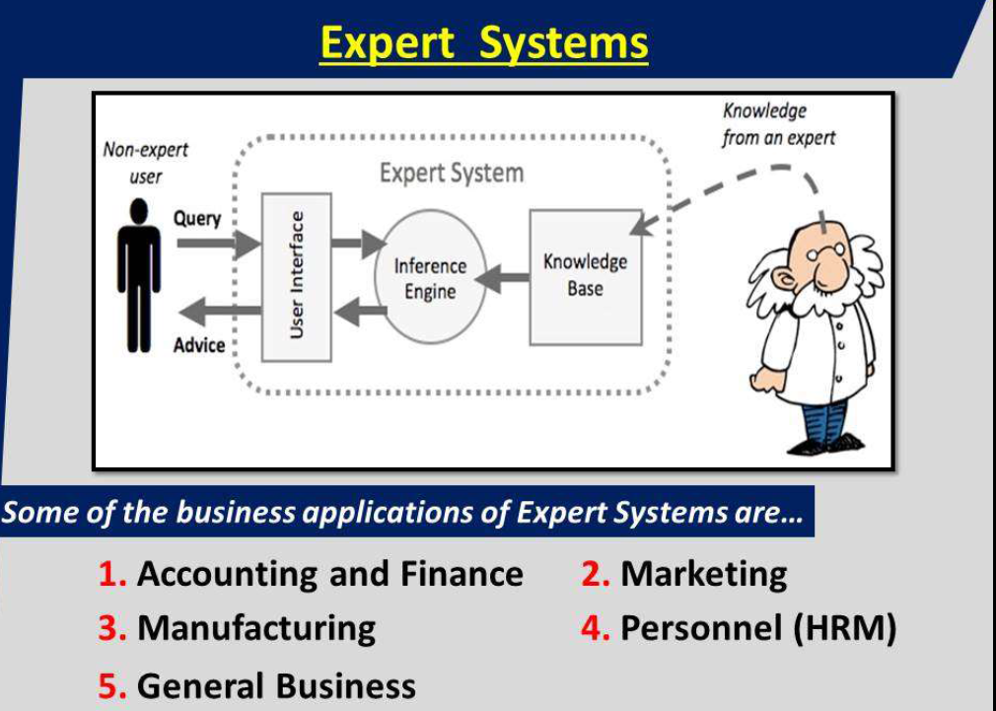

Slide 35
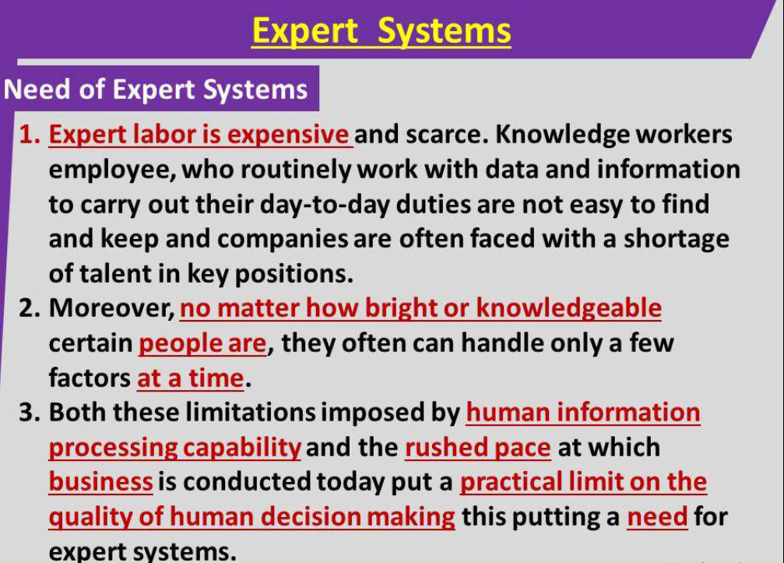

Slide 36
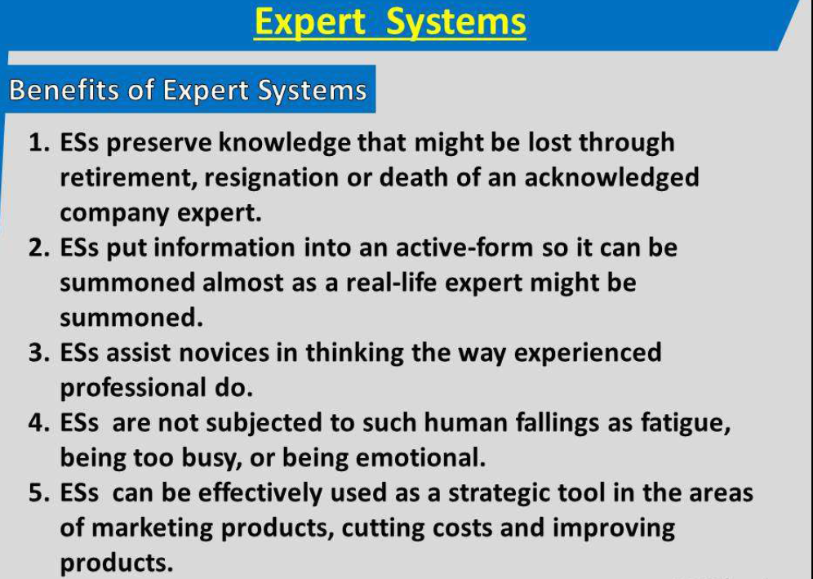

Slide 37
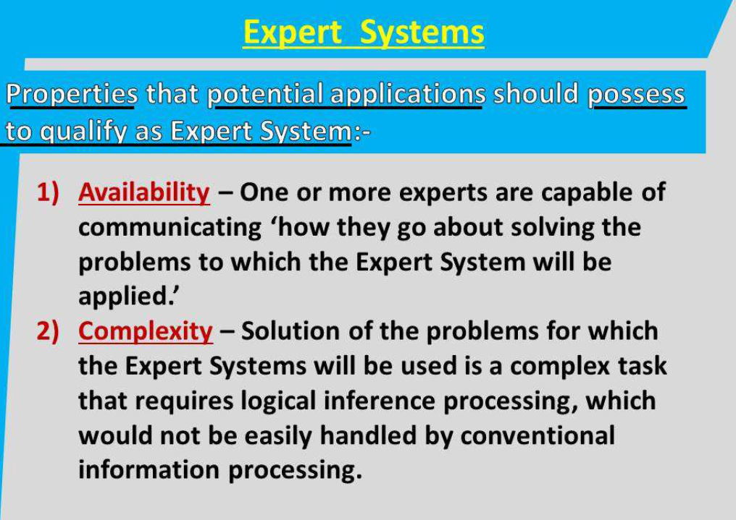

Slide 38
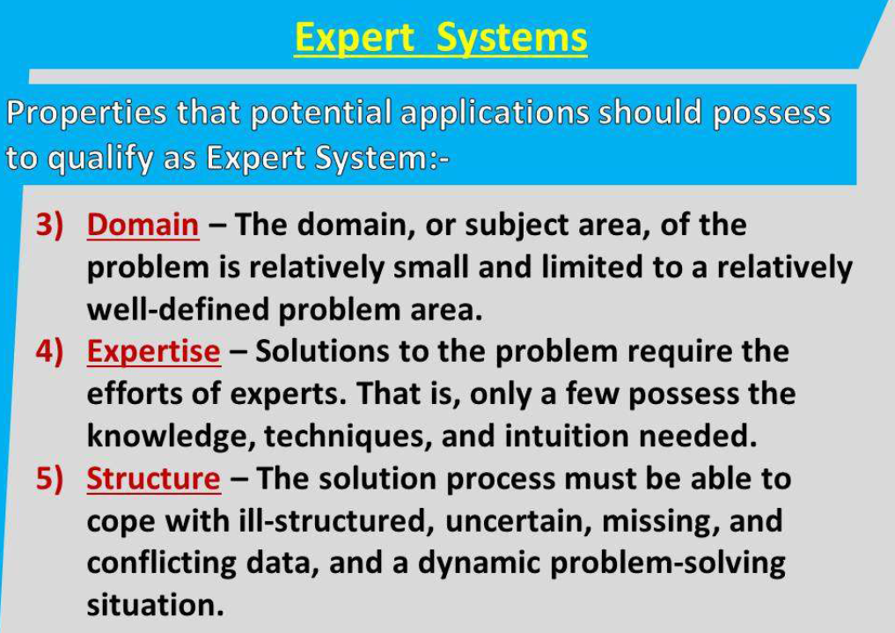

Slide 39
Executive Information Systems (EIS)

Slide 40
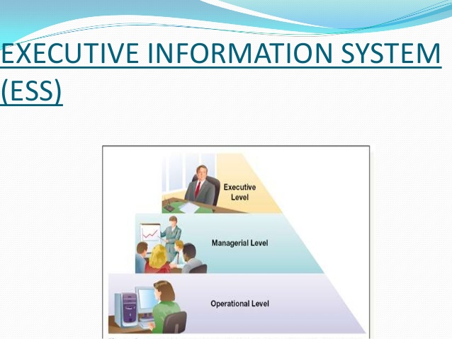

Slide 41
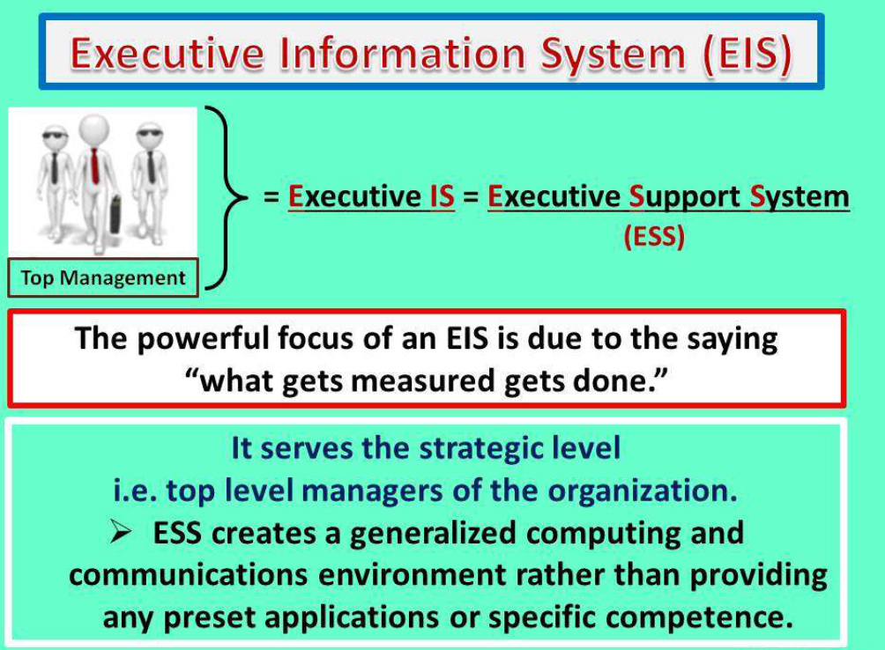

Slide 42
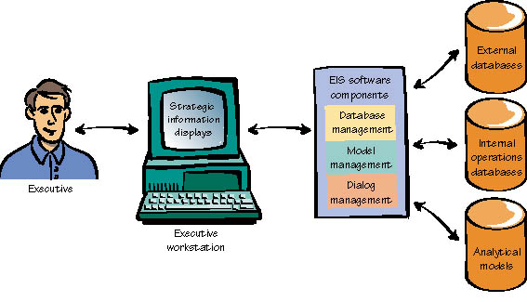
Executive Information Systems (EIS)
Used to monitor important economic and social trends affecting the company and corporate performance.

Slide 43
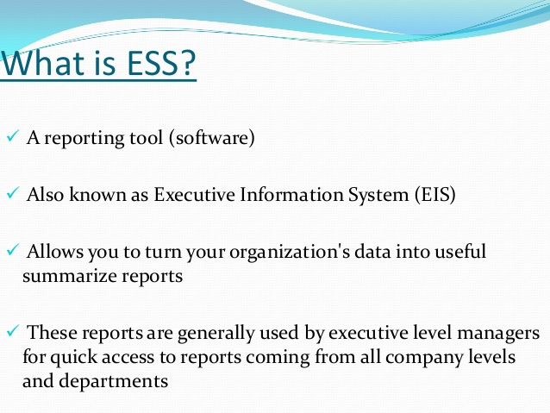

Slide 44
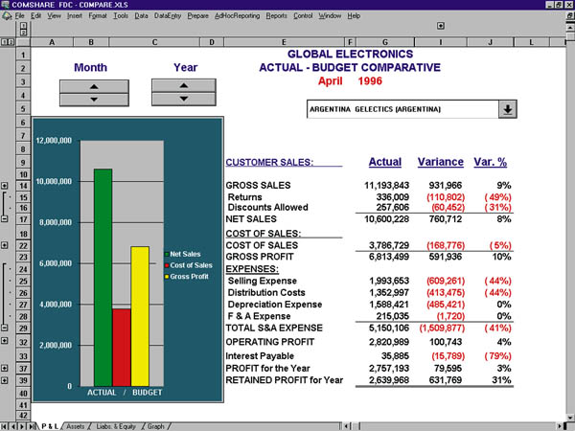
Executive Information Systems (EIS)
An executive can use the EIS to drill down through the available information to the level of detail needed.
Access to up to data internal and external information makes an EIS particularly helpful during the intelligence phase of decision making.

Slide 45
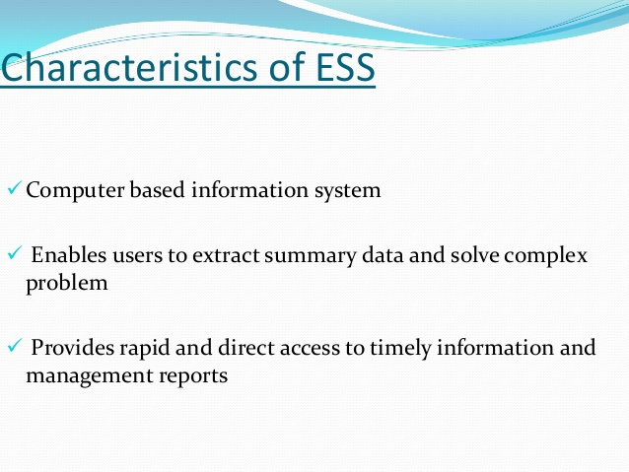

Slide 46
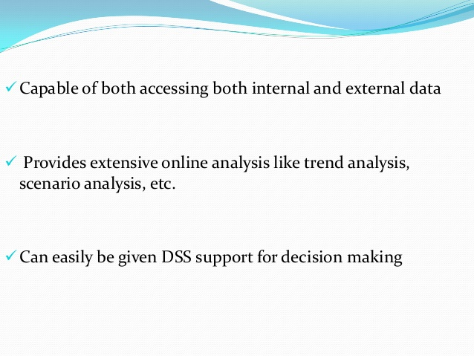

Slide 47
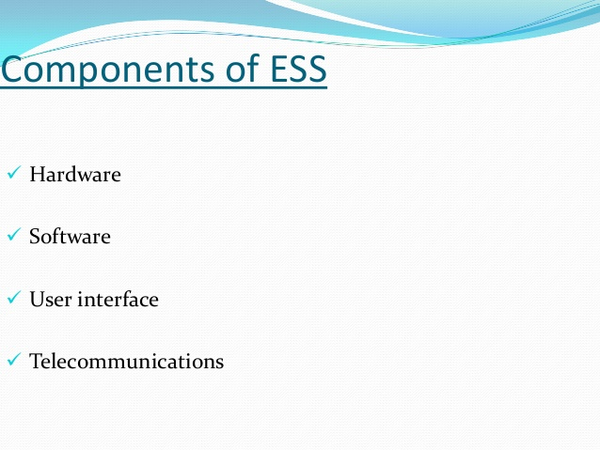

Slide 48
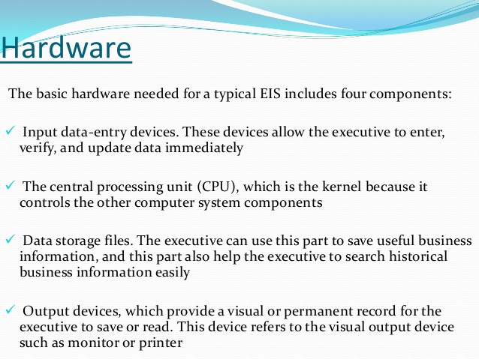

Slide 49
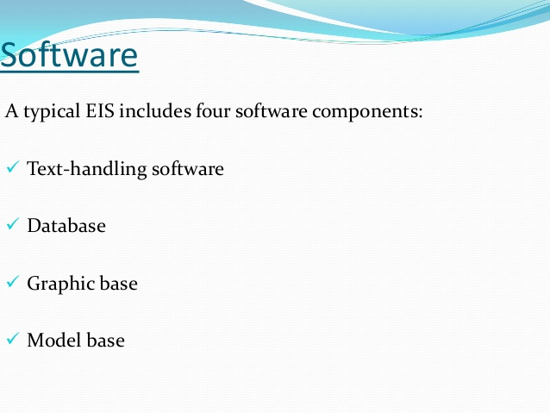

Slide 50
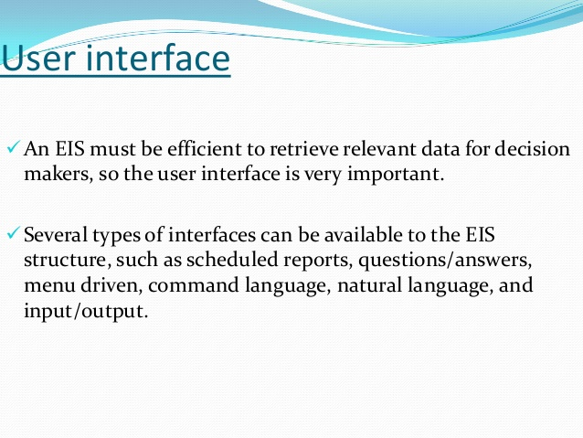

Slide 51
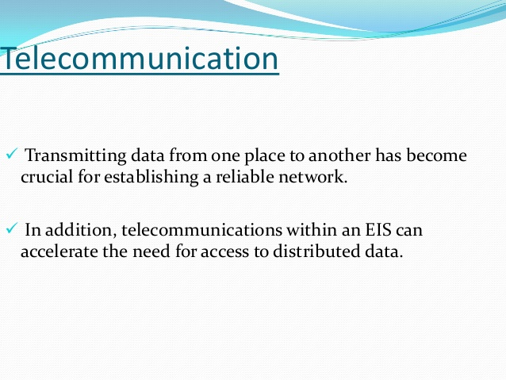

Slide 52
Enterprise Systems Or Enterprise Resource Planning (ERP)

Slide 53
Enterprise Systems Or Enterprise Resource Planning (ERP)
Before having an Enterprise systems, your decision making would often be based on manual hardcopy reports, often out of date, and it would be difficult to really understand what is happening in the business as a whole.
Sales personnel might not be able to tell at the time they place an order whether the ordered items are in inventory,
and manufacturing could not easily use sales data to plan for new production.

Slide 54
Cont…
Also called “enterprise resource planning (ERP) systems”
Suite of integrated software modules and a common central database
Collects data from many divisions of firm for use in nearly all of firm’s internal business activities
Information entered in one process is immediately available for other processes

Slide 55
What is ERP?
Enterprise Resource Planning (ERP) systems: Large, integrated, computer-based business transaction processing and reporting systems.
Its also known as Enterprise system
ERP systems pull together all of the classic business functions such as accounting, finance, sales, and operation into a single, tightly integrated package using a common database.
“Integration” is the key word for ERP implementation.

Slide 56
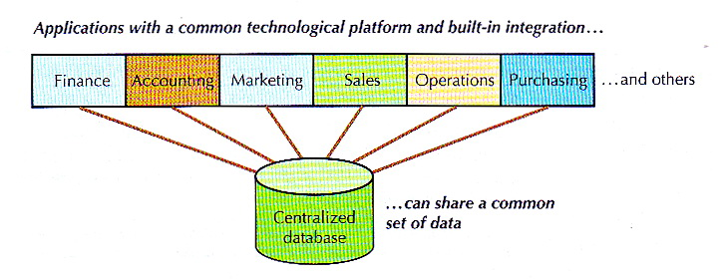

Slide 57
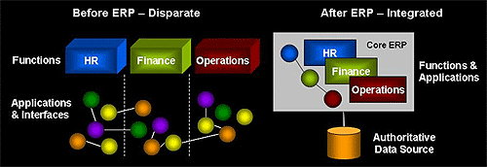
Organization: Before & After ERP

Slide 58
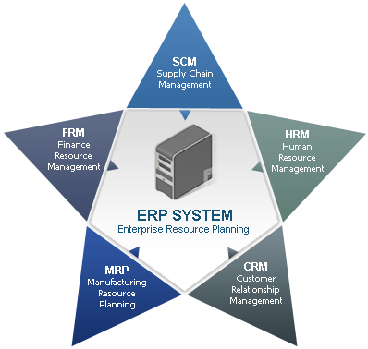
ERP
Characteristics of ERP
Integration
Packages
Assembly Requirement
Best Business Practice
Evolving System

Slide 59
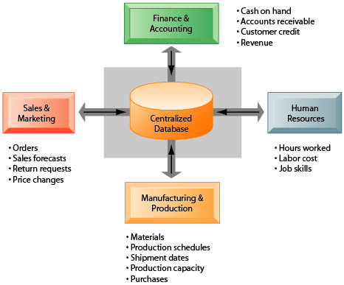
ERP Architecture

Slide 60
ERP Components
ERP modules
Finance and accounting
Sales and marketing
Production and materials management
Human resources

Slide 61
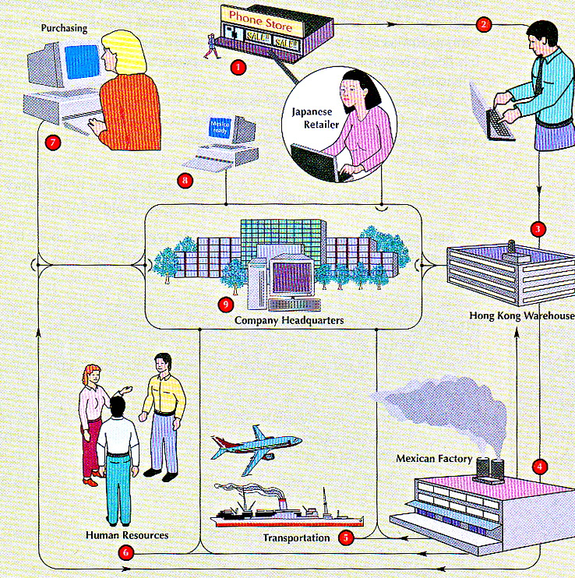

Slide 62
ERP Components
Finance and accounting - financial accounting, investment management, cost control ,treasury management, asset management, etc - providing consistent financial data updated in real time - linking operational results with the financial effects of those result

Slide 63
ERP Components
Sales and marketing - supporting customer-related activities such as order processing, product configuration, delivery quotation - allowing for profitability analysis (sales module) - reserving inventory for specific customer - billing, invoicing, rebate processing, etc.

Slide 64
ERP Components
Production and materials management - handing all types of manufacturing processes - interfacing with CAD program - allocating resources - scheduling and monitoring production - material management refer to supply chain related activities i.e. purchasing, inventory and warehouse functions, JIT delivery.

Slide 65
ERP Components
Human Resources - covering all personnel management tasks; workforce planning, employee scheduling, training and development, etc. - providing database of personnel - maintaining salary and benefit structure

Slide 66
Business value of enterprise systems or ERP
Increase operational efficiency
Large companies with many operating units in different locations have used enterprise systems to enforce standard practices and data so that everyone does business the same way worldwide.
Enable rapid responses to customer requests for information or products
Include analytical tools to evaluate overall organizational performance

Slide 67
Business value of enterprise systems or ERP
Enterprise systems provide much valuable information for improving management decision making.
Corporate headquarters has access to up-to-the-minute data on sales, inventory, and production, and uses this information to create more accurate sales and production forecasts.
Enterprise systems allow senior management to easily find out at any moment how a particular organizational unit is performing, determine which products are most or least profitable, and calculate costs for the company as a whole.

Slide 68
Potential Benefits of ERP
Internal Benefits
Integration of a single source of data
Common data definition
A real-time system
Increased productivity
Reduced operating costs
Improved internal communication
Foundation for future improvement

Slide 69
Potential Benefits of ERP
External Benefits
Improved customer service and order fulfillment
Improved communication with suppliers and customers
Enhanced competitive position
Increased sales and profits

Slide 70
SUPPLY CHAIN MANAGEMENT SYSYTEM

Slide 71
Supply Chain Management Systems
Supply chain:
Network of organizations and processes for:
Procuring raw materials
Transforming them into products
Distributing the products
2. Upstream supply chain:
Firm’s suppliers, suppliers’ suppliers, processes for managing relationships with them
3. Downstream supply chain:
Organizations and processes responsible for delivering products to customers

Slide 72
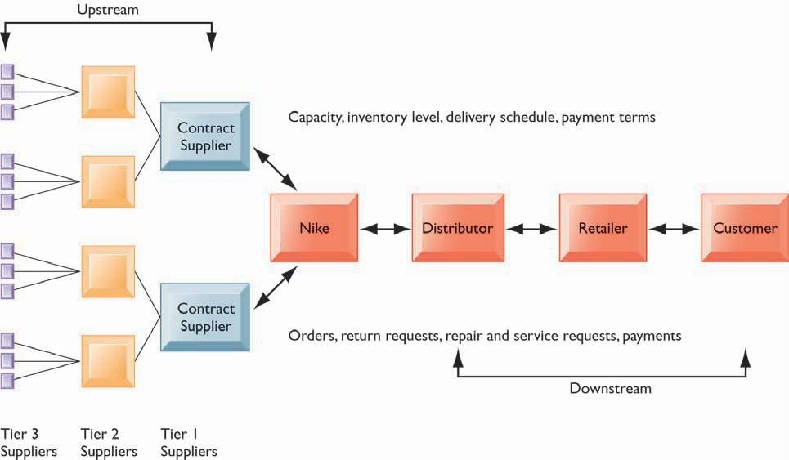
Supply Chain Management Systems

Slide 73
The figure illustrates the major entities in Nike’s supply chain and the flow of information upstream and downstream to coordinate the activities involved in buying, making, and moving a product. Shown here is a simplified supply chain, with the upstream portion focusing only on the suppliers for sneakers and sneaker soles.

Slide 74
Supply Chain Management Systems
Information and supply chain management
Inefficiencies cut into a company’s operating costs
Can waste up to 25% of operating expenses
Just-in-time strategy:
Components arrive as they are needed
Finished goods shipped after leaving assembly line
If a manufacturer had perfect information about exactly how many units of product customers wanted, when they wanted them, and when they could be produced,
Safety stock
Buffer for lack of flexibility in supply chain
Bullwhip effect
Information about product demand gets distorted as it passes from one entity to next across supply chain

Slide 75

Supply Chain Management Systems
The Bullwhip effect
Inaccurate information can cause minor fluctuations in demand for a product to be amplified as one moves further back in the supply chain. Minor fluctuations in retail sales for a product can create excess inventory for distributors, manufacturers, and suppliers.

Slide 76
Supply Chain Management Systems
The bullwhip is tamed by:
reducing uncertainties about demand and supply when all members of the supply chain have accurate and up-to-date information.
If all supply chain members share dynamic information about inventory levels, schedules, forecasts, and shipments, they have more precise knowledge about how to adjust their sourcing, manufacturing, and distribution plans.
Supply chain management systems provide the kind of information that helps members of the supply chain make better purchasing and scheduling decisions.

Slide 77
Supply Chain Management Systems
Supply chain management software
Supply chain planning systems, enables the firm to:
Model existing supply chain
Generate Demand planning: how much product a business needs to make to satisfy all of its customers’ demands
Optimize sourcing, manufacturing plans
Establish inventory levels
Identifying transportation modes
Supply chain execution systems
manage the flow of products through distribution centers and warehouses to ensure that products are delivered to the right locations in the most efficient manner.
track the physical status of goods, the management of materials, warehouse and transportation operations

Slide 78
Supply Chain Management Systems
Global supply chain issues
Global supply chains typically span greater geographic distances and time differences
More complex pricing issues (local taxes, transportation, etc.)
Foreign government regulations
Internet helps companies manage many aspects of global supply chains
Sourcing, transportation, communications, international finance

Slide 79
Supply Chain Management Systems
Supply chain management systems
Push-based model (build-to-stock)
Schedules based on best guesses of demand
Pull-based model (demand-driven)
Customer orders trigger events in supply chain
Sequential supply chains
Information and materials flow sequentially from company to company
Concurrent supply chains
Information flows in many directions simultaneously among members of a supply chain network- enabled by Internet and Internet technology.

Slide 80

Supply Chain Management Systems
The bullwhip Effect
The difference between push- and pull-based models is summarized by the slogan, “Make what we sell, not sell what we make.”

Slide 81
Supply Chain Management Systems
Business value of SCM systems
Match supply to demand
Reduce inventory levels
Improve delivery service
Speed product time to market
Use assets more effectively
Reduced supply chain costs lead to increased profitability
Increased sales, More precise control of the supply chain enhances the firm’s ability to have the right product available for customer purchases at the right time.

Slide 82
Customer Relationship Management Systems

Slide 83
Customer Relationship Management Systems
Knowing the customer
In large businesses, too many customers and too many ways customers interact with firm
you’d want to make sure you knew each of your customers well, as if you were running a small town store. And you’d want to make your good customers feel special.
Customer relationship management (CRM) systems
Capture and integrate customer data from all over the organization
Consolidate and analyze customer data
Distribute customer information to various systems and customer touch points across enterprise
Provide single enterprise view of customers

Slide 84

Customer Relationship Management Systems
CUSTOMER RELATIONSHIP MANAGEMENT (CRM)
CRM systems examine customers from a multifaceted perspective. These systems use a set of integrated applications to address all aspects of the customer relationship, including customer service, sales, and marketing.

Slide 85
Customer Relationship Management Systems
Good CRM systems provide data and analytical tools for answering questions such as:
What is the value of a particular customer to the firm over his or her lifetime?
Who are our most loyal customers?
Who are our most profitable customers?
What do these profitable customers want to buy?
Firms use the answers to these questions:
to acquire new customers,
provide better service and support to existing customers,
customize their offerings more precisely to customer preferences,
and provide ongoing value to retain profitable customers.

Slide 86
Customer Relationship Management Systems
CRM software
CRM packages range from niche tools (perform limited functions, such as personalizing Web sites for specific customers) to large-scale enterprise applications.
More comprehensive CRM have modules for:
Partner relationship management (PRM)
to enhance collaboration between a company and its selling partners.
If a company does not sell directly to customers but rather works through distributors or retailers, PRM helps these channels sell to customers directly.
Integrating lead generation, pricing, promotions, order configurations, and availability.
Tools to assess partners’ performances

Slide 87
Customer Relationship Management Systems
Employee relationship management (ERM)
– deals with employee issues that are closely related to CRM, such as employee performance management, performance- based compensation, and employee training.

Slide 88
Customer Relationship Management Systems
CRM packages typically include tools for:
Sales force automation (SFA)
A module in CRM systems help sales staff increase their productivity by focusing sales efforts on the most profitable customers
E.g. sales prospect and contact information, order processing, and order tracking.
Customer service
provide information and tools to increase the efficiency of call centers, help desks, and customer support staff.
E.g. assigning and managing customer service requests; Web- based self-service capabilities

Slide 89
Customer Relationship Management Systems
Improved access to consistent and accurate customer information helps call centers:
handle more calls per day and decrease the duration of each call.
achieve greater productivity,
reduced transaction time, and higher quality of service at lower cost.
Marketing
CRM systems support direct-marketing campaigns by:
providing capabilities for capturing prospect and customer data,
scheduling and tracking direct-marketing mailings or e-mail,
tools for analyzing marketing and customer data, identifying profitable and unprofitable customers, designing products and services to satisfy specific customer needs and interests, and identifying opportunities for cross-selling.

Slide 90

Customer Relationship Management Systems
HOW CRM SYSTEMS SUPPORT MARKETING
Customer relationship management software provides a single point for users to manage and evaluate marketing campaigns across multiple channels, including e- mail, direct mail, telephone, the Web, and wireless messages.

Slide 91

Customer Relationship Management Systems
CRM SOFTWARE CAPABILITIES
The major CRM software products support business processes in sales, service, and marketing, integrating customer information from many different sources. Included are support for both the operational and analytical aspects of CRM.

Slide 92

Customer Relationship Management Systems
CUSTOMER LOYALTY MANAGEMENT PROCESS MAP
This process map shows how a best practice for promoting customer loyalty through customer service would be modeled by customer relationship management software. The CRM software helps firms identify high-value customers for preferential treatment.

Slide 93
Customer Relationship Management Systems
Operational CRM:
Customer-facing applications
E.g. sales force automation, call center and customer service support, and marketing automation
Analytical CRM:
Analyze customer data output from operational CRM applications to provide information for improving business performance.
Based on data warehouses populated by operational CRM systems and customer touch points
Such data are analyzed to identify buying patterns, to create segments for targeted marketing, and to pinpoint profitable and unprofitable customers
Customer lifetime value (CLTV): the relationship between the revenue produced by a specific customer, the expenses incurred in acquiring and servicing that customer, and the expected life of the relationship between the customer and the company.

Slide 94
Customer Relationship Management Systems
Business value of CRM
Increased customer satisfaction
Reduced direct-marketing costs
More effective marketing
Lower costs for customer acquisition/retention
Increased sales revenue
Reduce churn rate (the annual percentage rate at which customers stop subscribing to a service )
Number of customers who stop using or purchasing products or services from a company.
Indicator of growth or decline of firm’s customer base

